Slide 1

Easy Enroll Online Course Software Final Project Presentation
Jeremy Roosa
The University of Arizona Global Campus
CST 499: Capstone for Computer Software Technology
Instructor: Amr Elchouemi
January 18, 2022

Slide 2

INTRODUCTION
The Easy Enroll Online Course Software System.
The Key Aspects of the SRS Document that was Developed in Week 1 and revised.
The UML Design Model that was created in Week 2 and revised.
The landing, login, and enrollment pages that were created in Week 3 and revised.
The MySQL database and class registration page that was developed in Week 4 and revised.
The PHP code that was written for the CST 499 course and revised.

Slide 3

The Easy Enroll Online Course Software System
Requirements for the system. SRS will be broken down in the video submission
Account and profile creation.
System should guard against two users using the same ID for registration.
Profiles must include some key information.
Online courses run through three semesters per year.
Each course should have a maximum number of enrollment.
If a user wants to enroll into a course and the course is full, the student can add themselves onto a waiting list.
A user can also cancel the enrollment from any course that they are enrolled in, and the system should inform the first in the waiting list (if any) that they can enroll into the class.

Slide 4
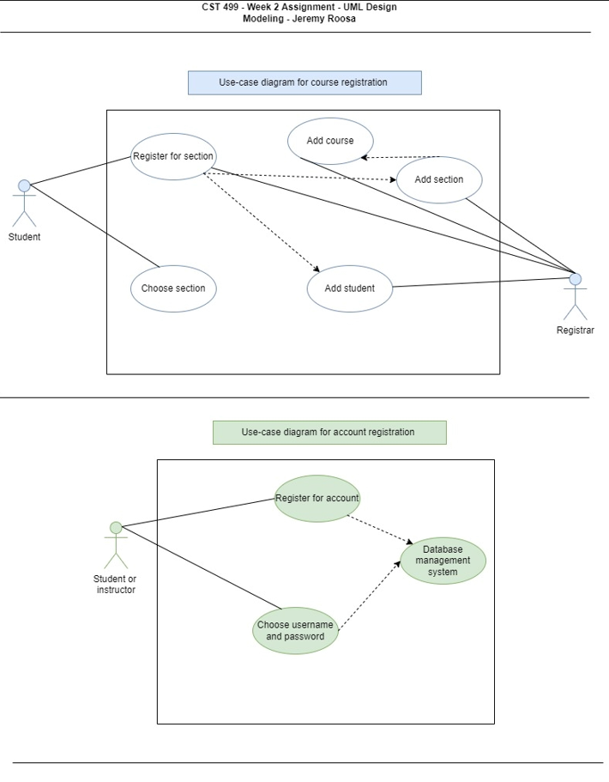

UML Models

Slide 5
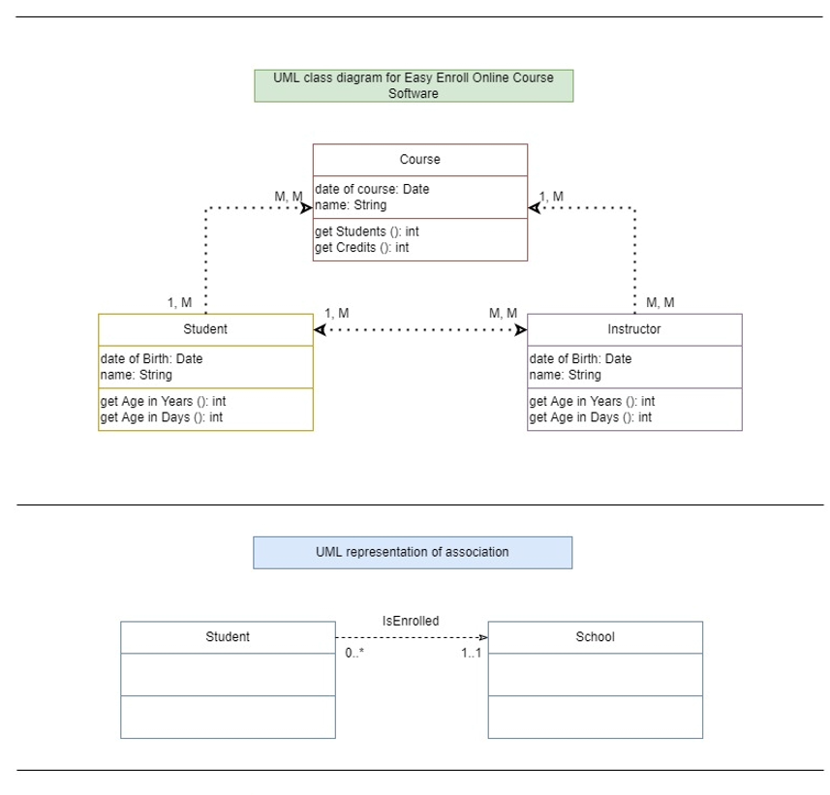
UML Models Continued Pt. 2

Slide 6
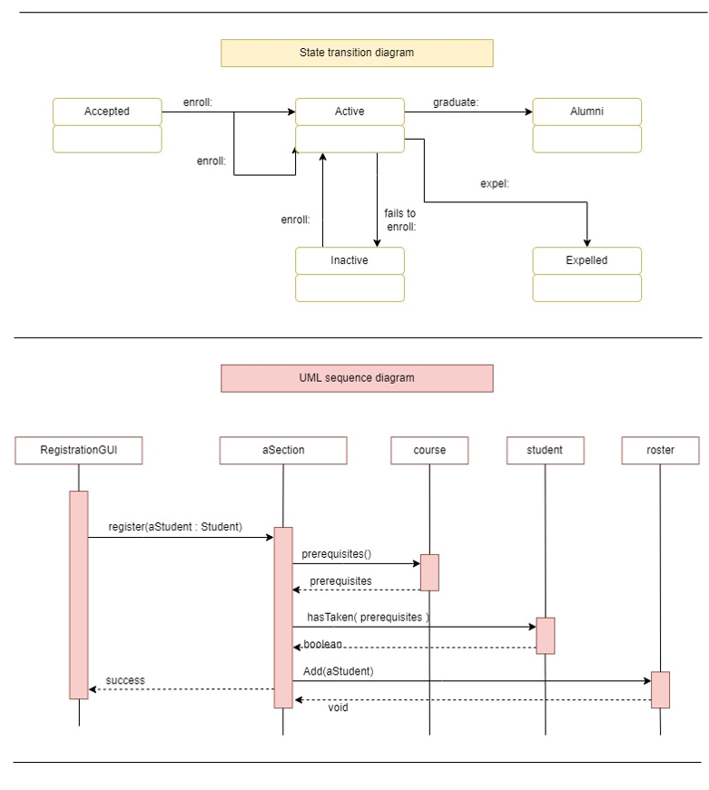
UML Models Continued Pt. 3

Slide 7
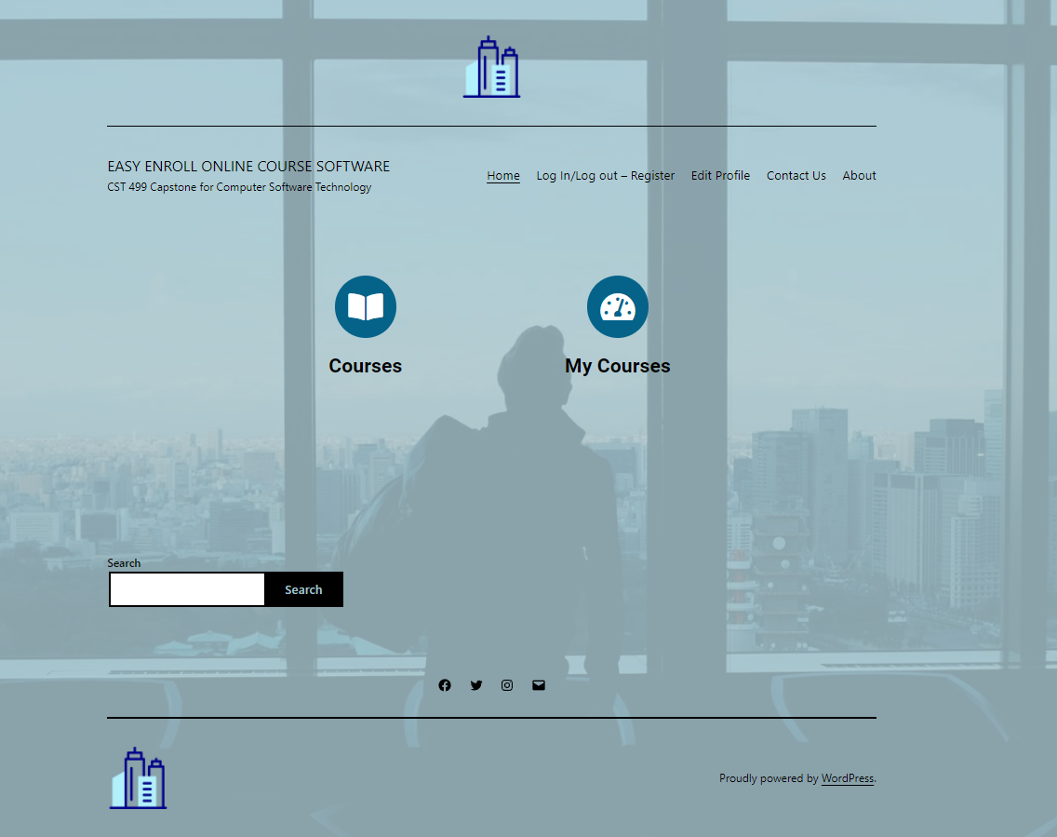
Landing Page

Slide 8
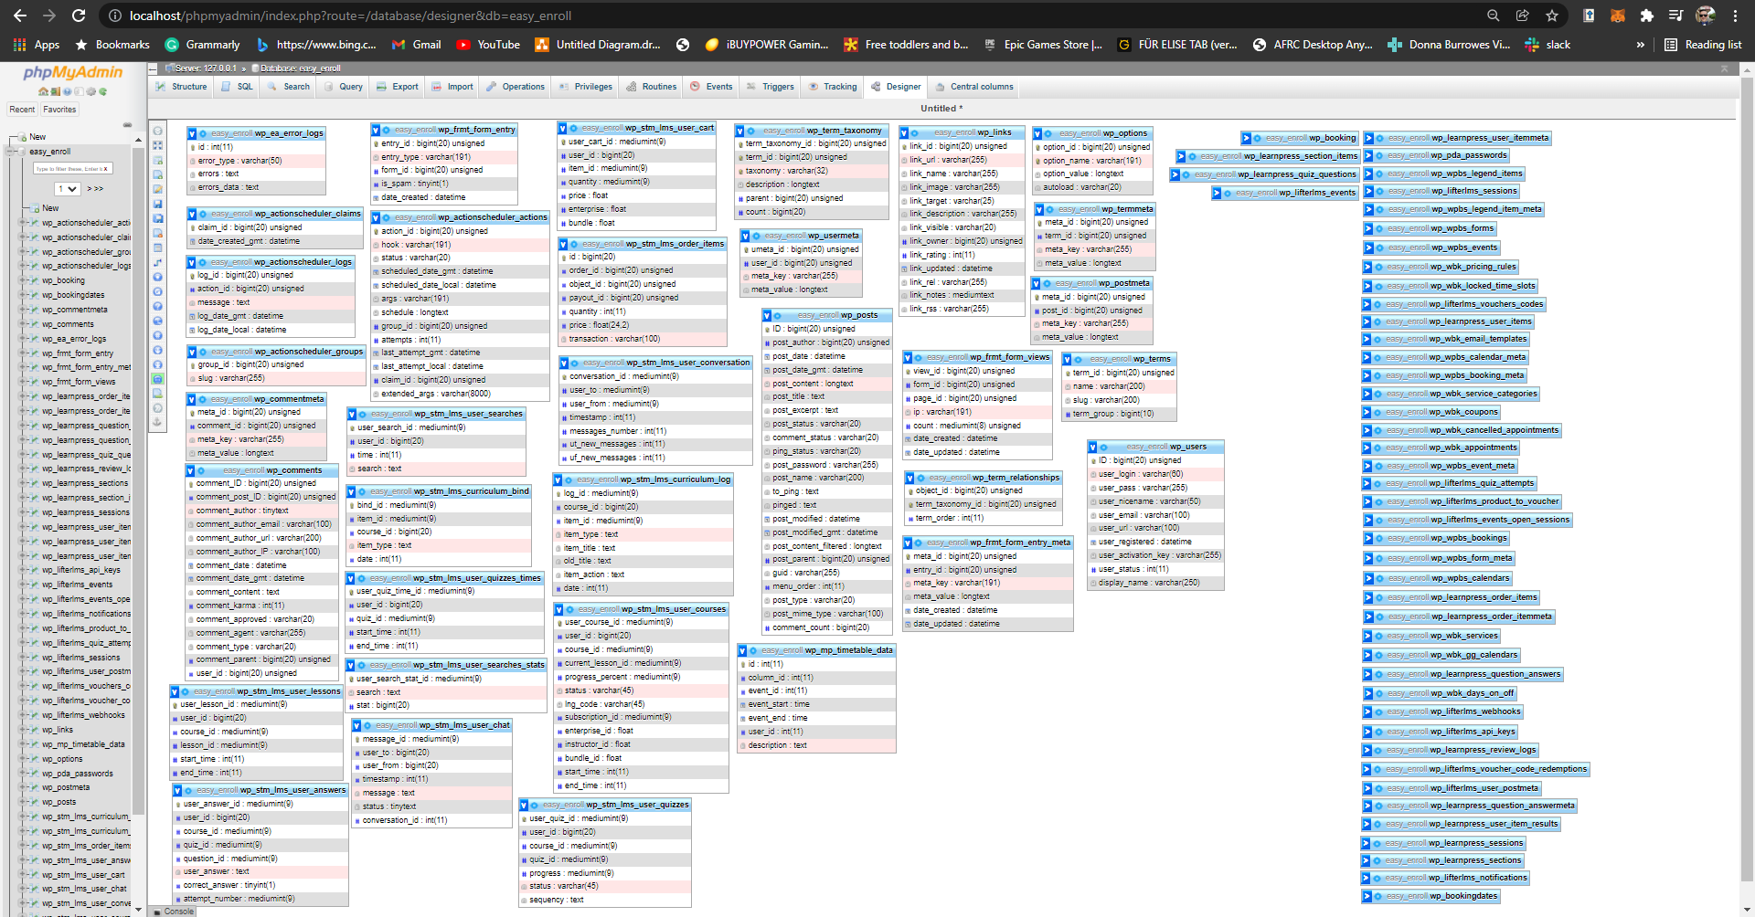
The MySQL Database

Slide 9
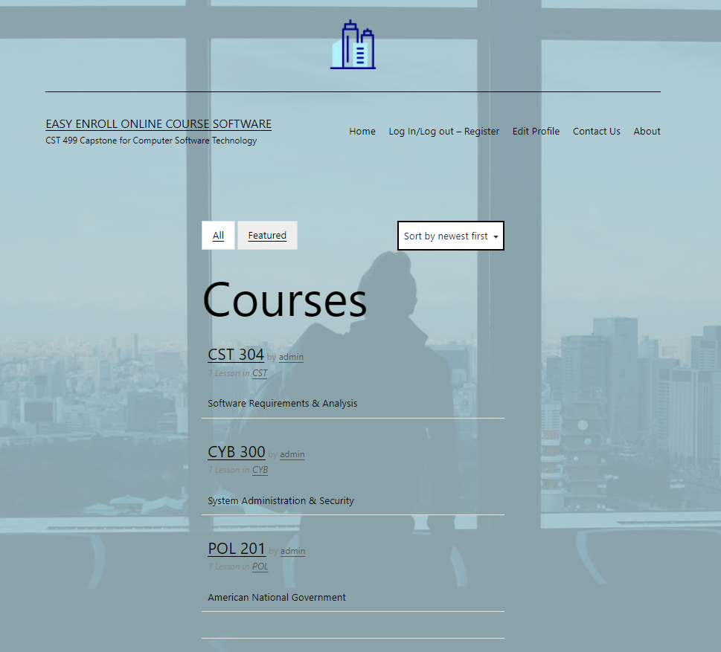
Class Registration Page

Slide 10

Conclusion
SRS document.
UML Design Models.
Landing, Login, and Enrollment pages.
MySQL database and class registration pages.
PHP Code that was written for the CST 499 course.

Slide 11

THANK YOU!
Jeremy Roosa
The University of Arizona Global Campus
CST 499: Capstone for Computer Software Technology
Instructor: Amr Elchouemi
January 18, 2022

Slide 12
References
Aayushi, J., (2019, July 16). How to Run a PHP program in Xampp? Step by Step Guide | Edureka. Edureka. https://www.edureka.co/blog/how-to-run-a-php-program-in-xampp/
Agrona, C., (2018). Hooks: Actions and Filters - Sensei LMS. Sensei LMS. https://senseilms.com/documentation/hooks-actions-and-filters/
Black, R. (2017). System Testing. SearchSoftwareQuality; TechTarget. https://searchsoftwarequality.techtarget.com/definition/system-testing
Craft, J., (2021). Acceptance Testing. Tutorialspoint.com. https://www.tutorialspoint.com/software_testing_dictionary/acceptance_testing.htm

Slide 13
References
Faiza, J., (2021). The 12 Do’s and Don’ts of Web Design | Adobe XD Ideas. Ideas. https://xd.adobe.com/ideas/principles/web-design/12-dos-donts-web-design-2/
Hamilton, T., (2021). What is Component Testing? Techniques, Example Test Cases. Guru99. https://www.guru99.com/component-testing.html
Lyubov, T., (2020). Non-Functional Requirements: A Guide With Concrete Examples - Plutora. Plutora. https://www.plutora.com/blog/non-functional-requirements-guide
Paol, F., (2019). IONOS Digital Guide. XAMPP tutorial: installation and first steps. IONOS Digitalguide. https://www.ionos.com/digitalguide/server/tools/xampp-tutorial-create-your-own-local-test-server/

Slide 14
References
Petra, O., (2020). Metadata. Techterms.com. https://techterms.com/definition/metadata
Roberts, T., (2017). How reusable is open source software? | 18F: Digital service delivery. Gsa.gov. https://18f.gsa.gov/2017/10/23/how-reusable-is-open-source-software/
Syed, B., (2019, September 23). Beginner’s Guide to WordPress Database Management with phpMyAdmin. WPBeginner. https://www.wpbeginner.com/beginners-guide/beginners-guide-to-wordpress-database-management-with-phpmyadmin/
Tsui, F., Karam, O., & Bernal, B. (2018). Essentials of software engineering (4th ed.). Jones & Bartlett Learning.

